Slide 1
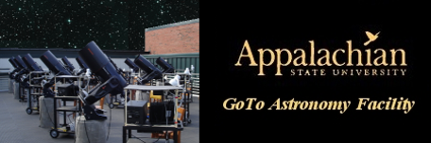
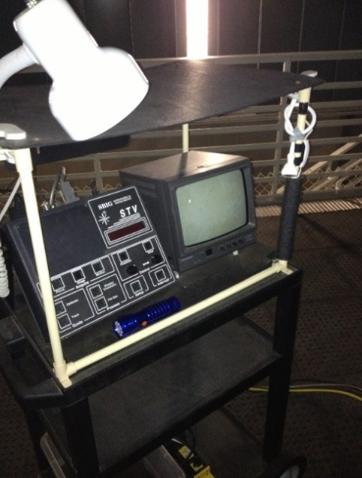
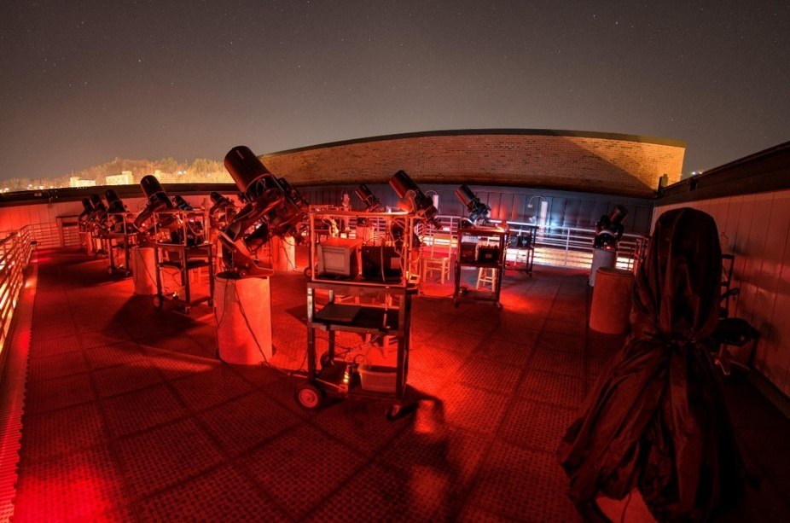
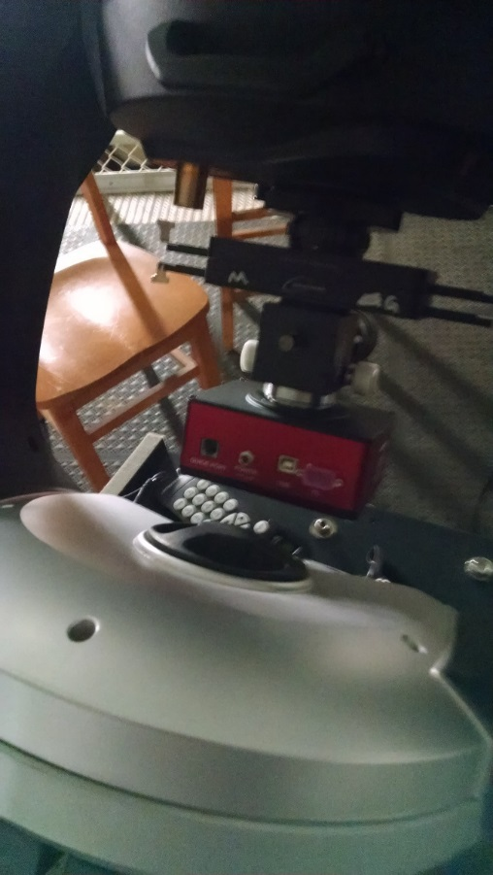
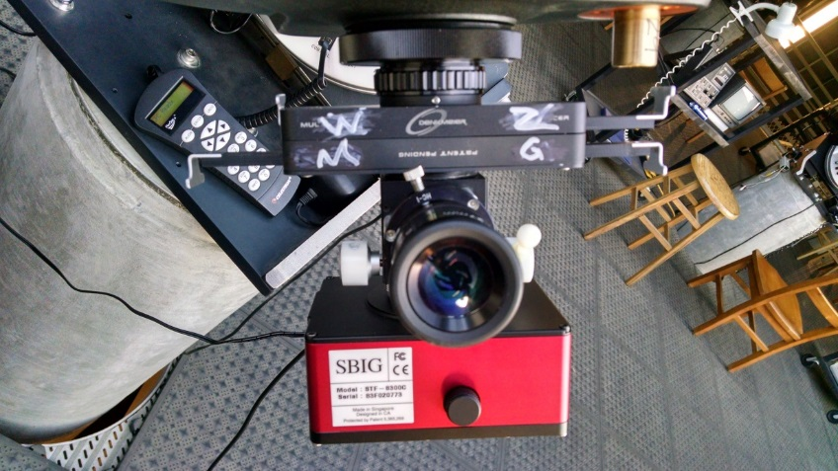
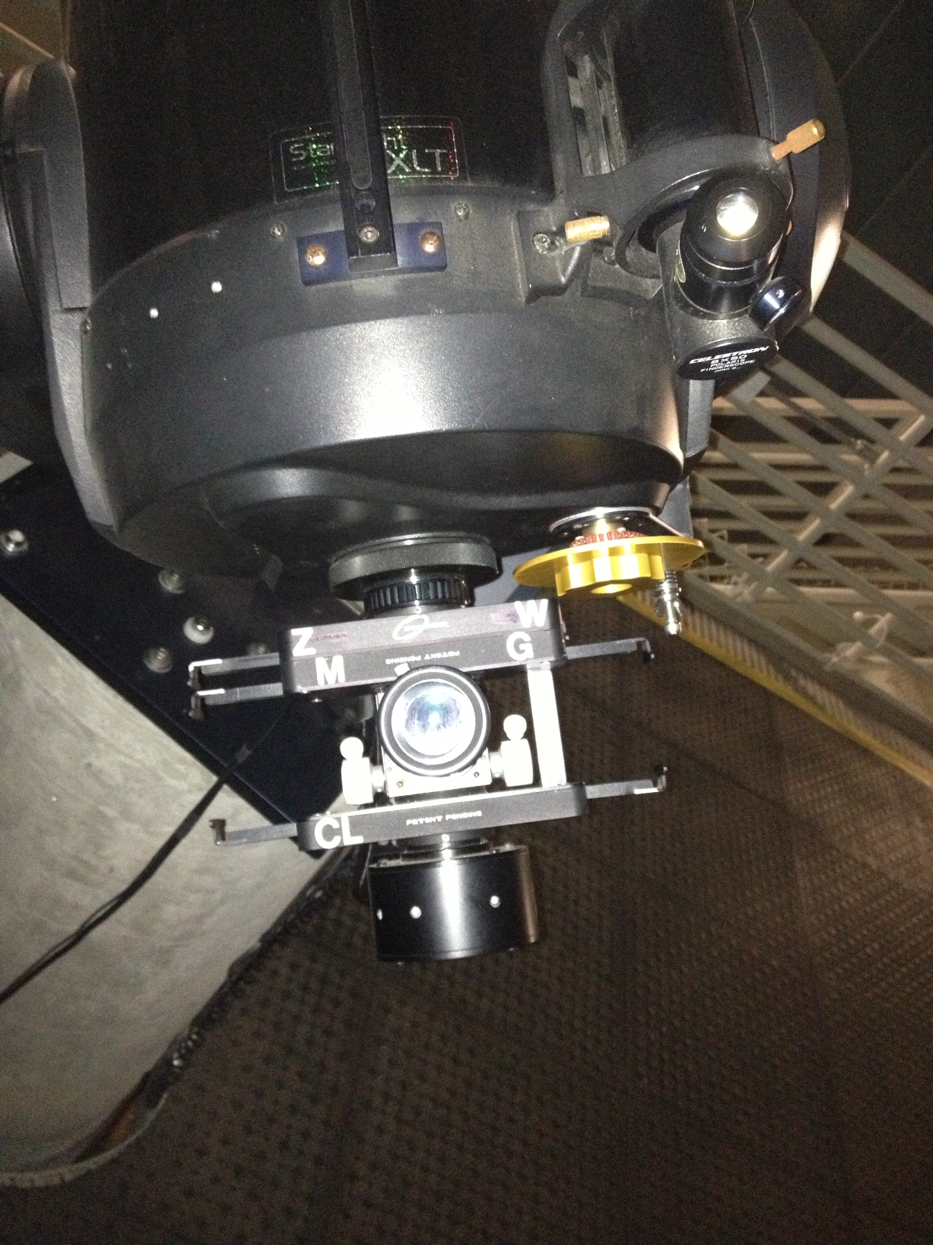
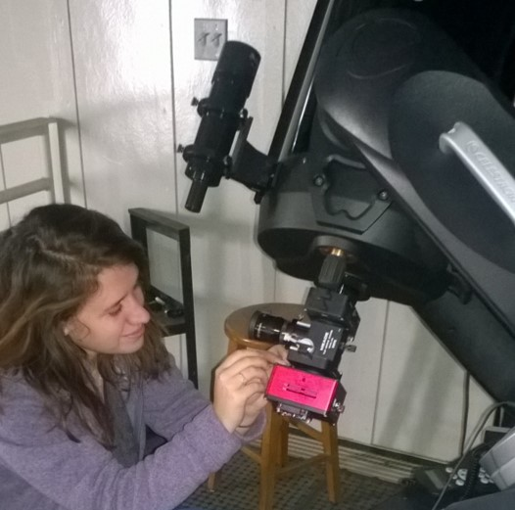
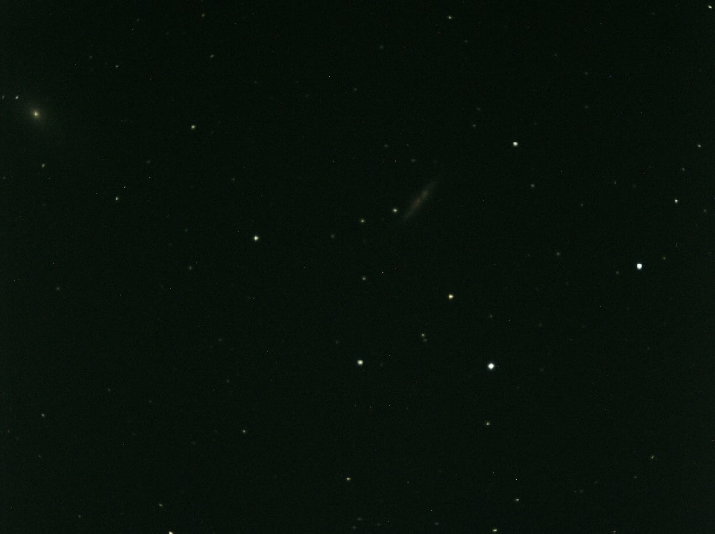
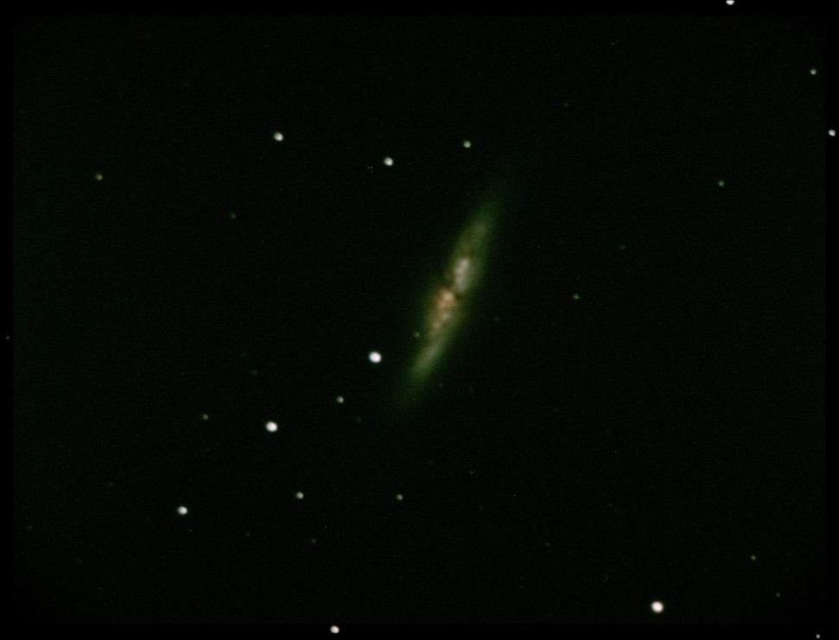
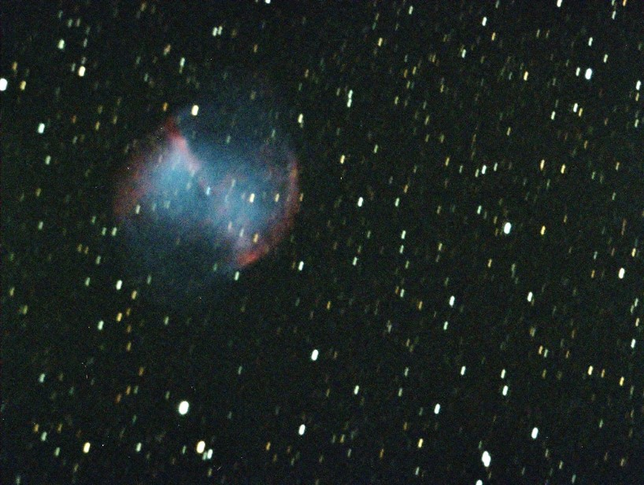
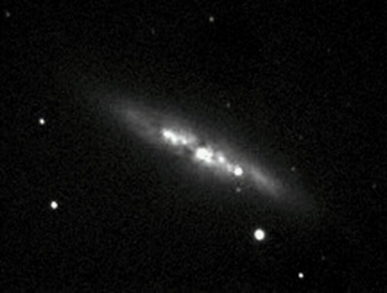
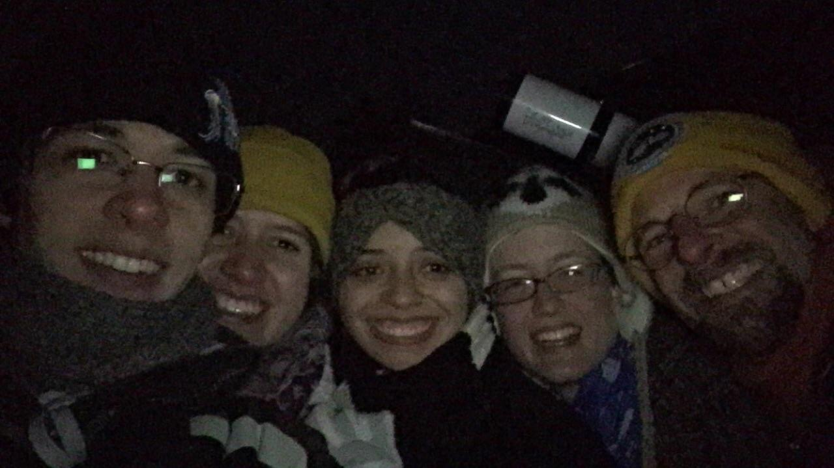
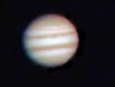
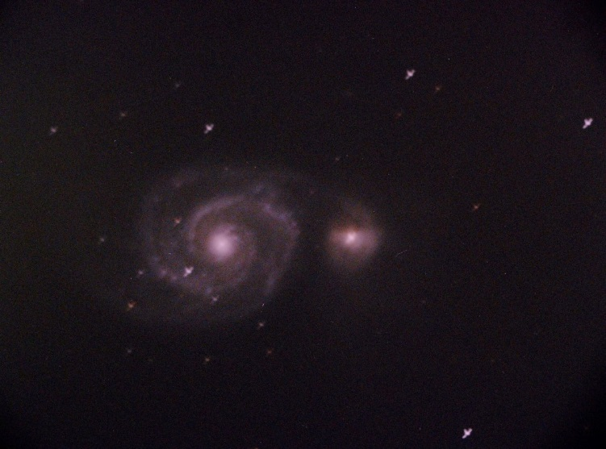
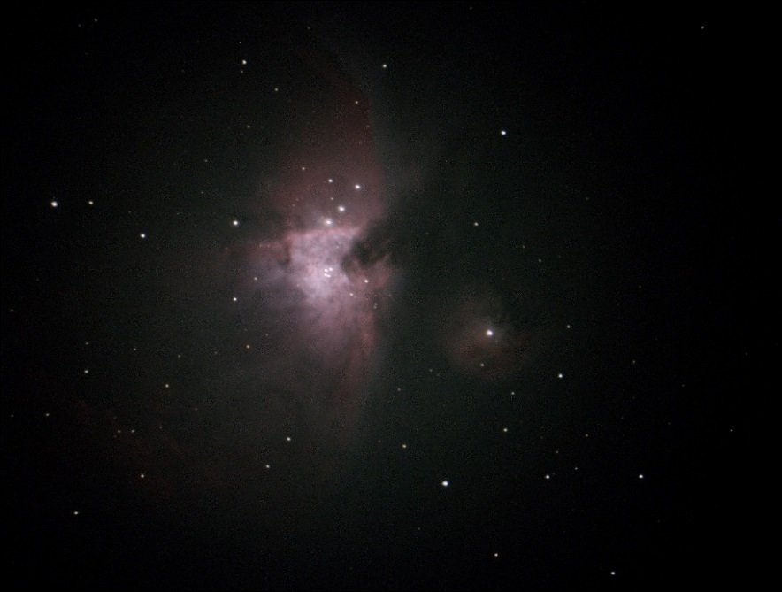
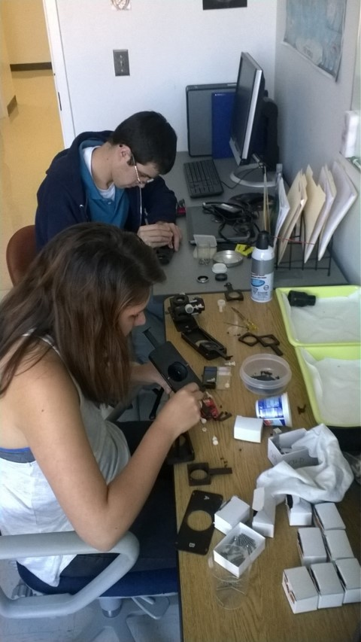
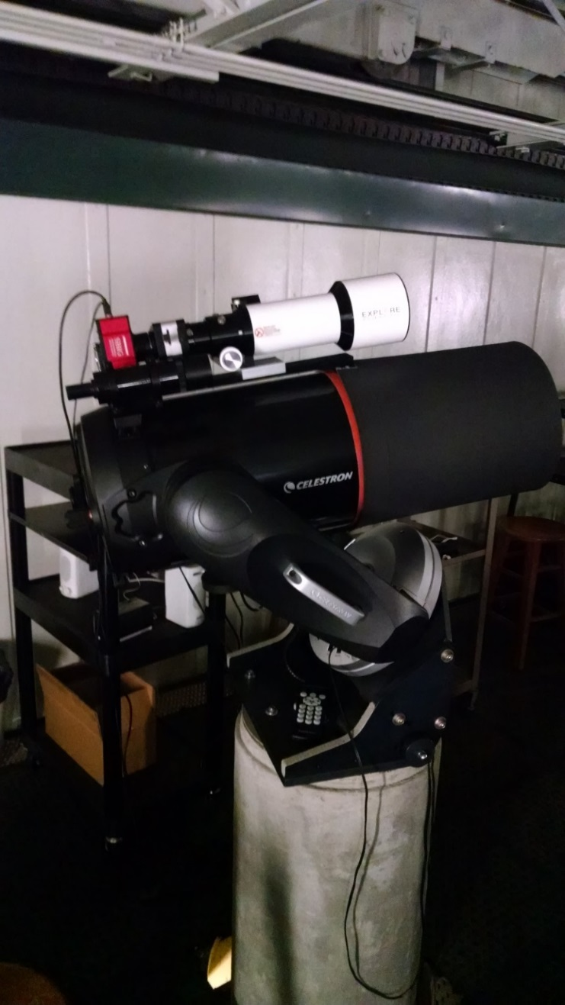
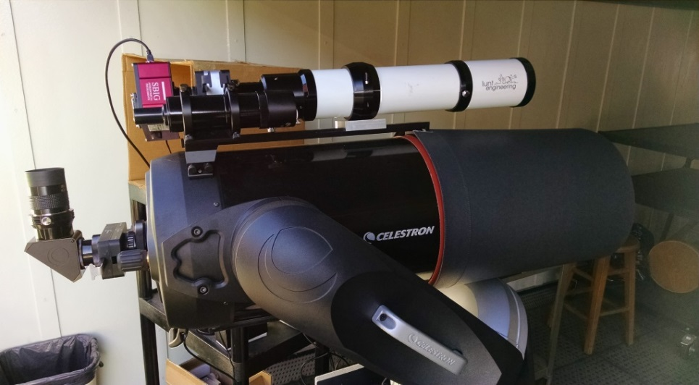
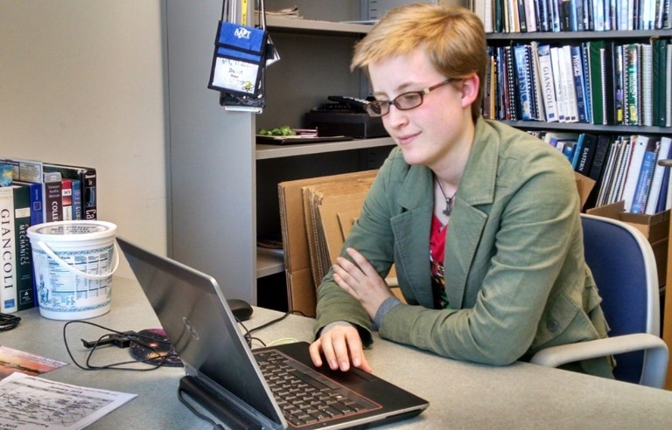
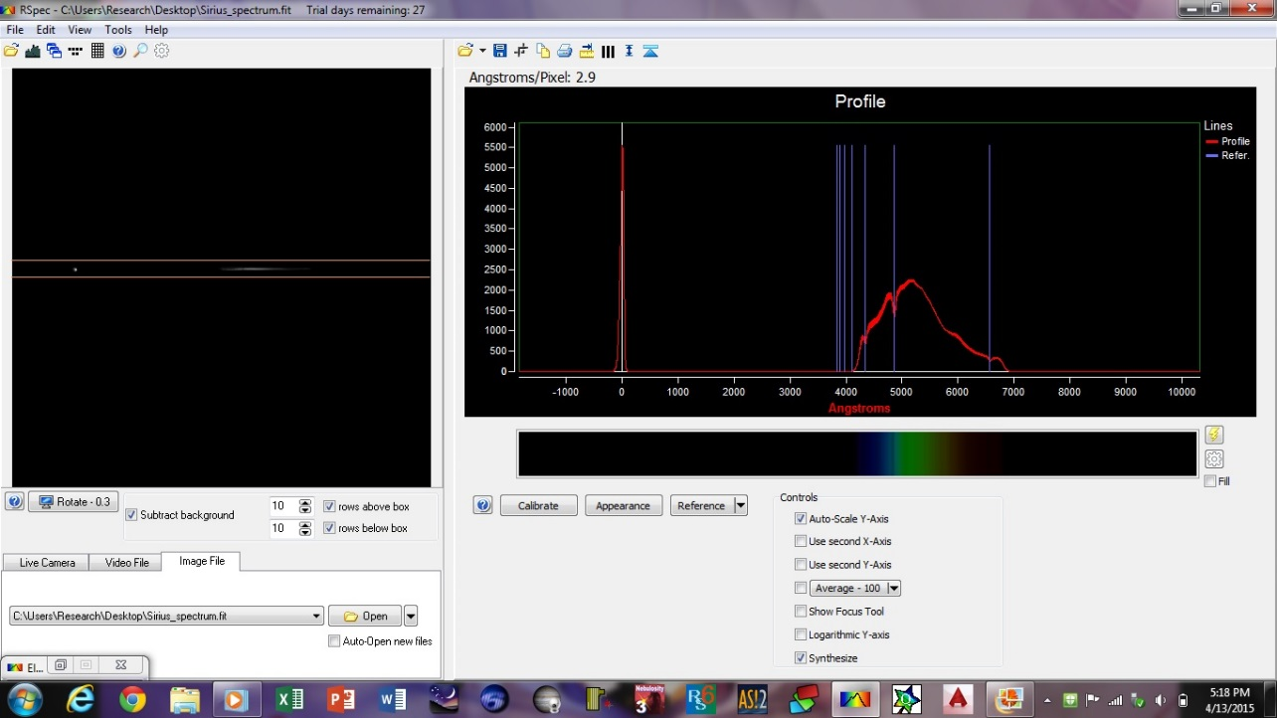
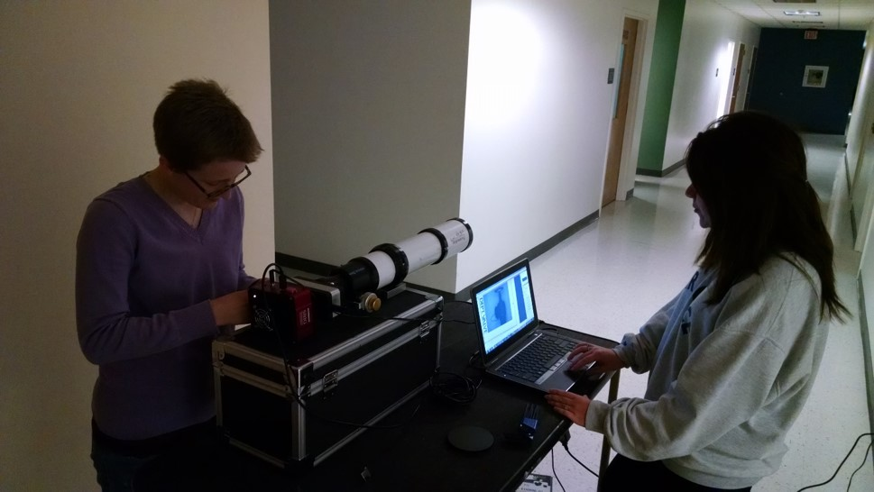
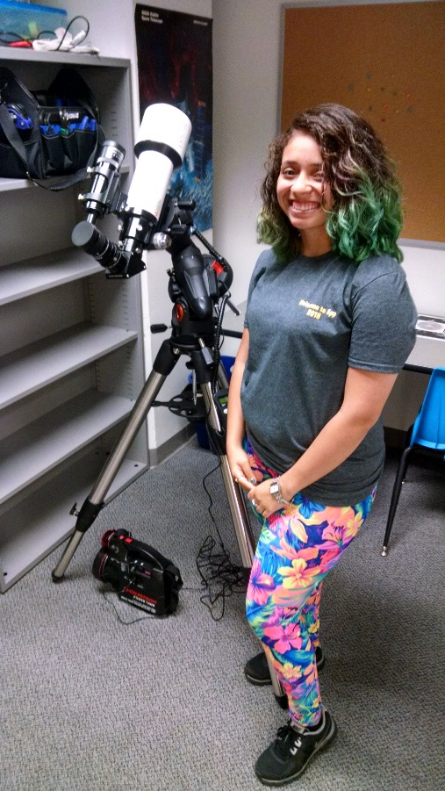
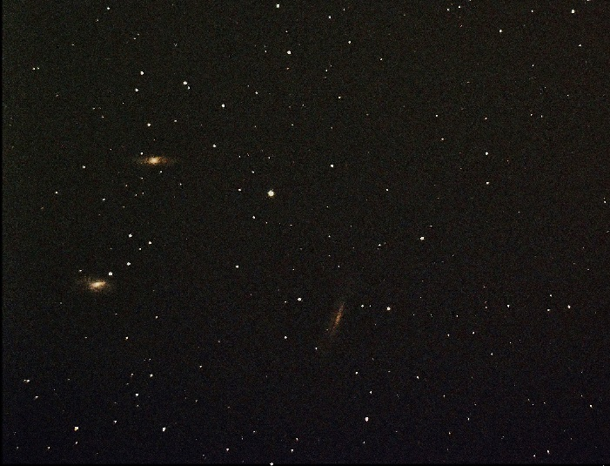
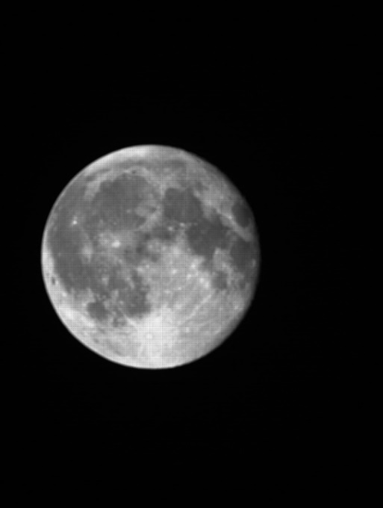
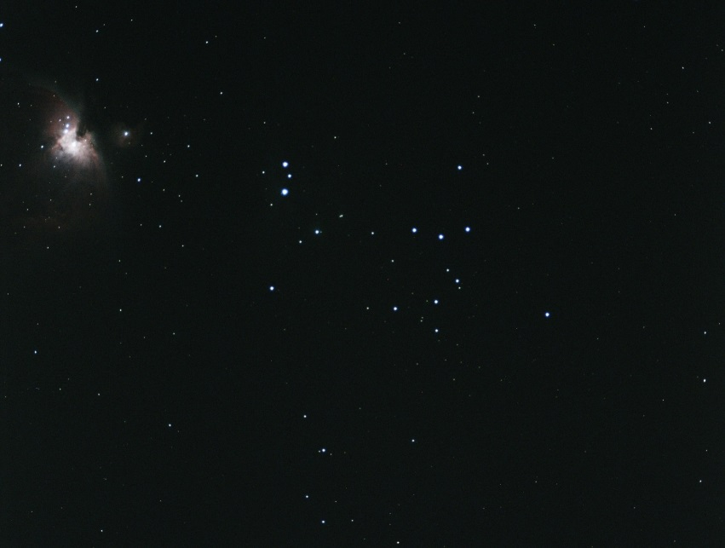
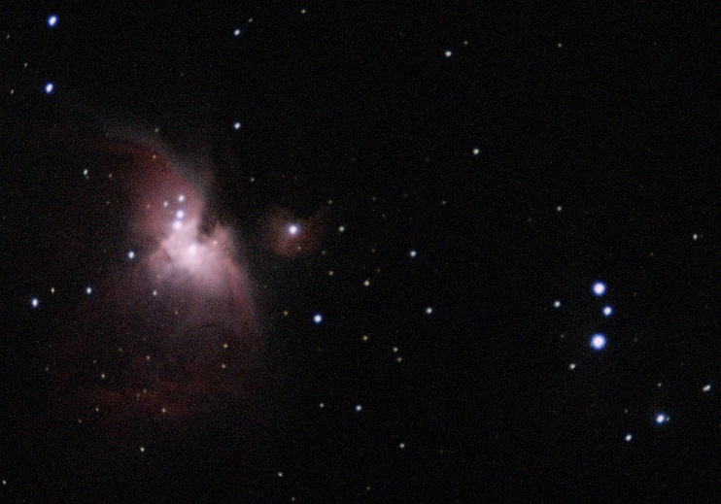
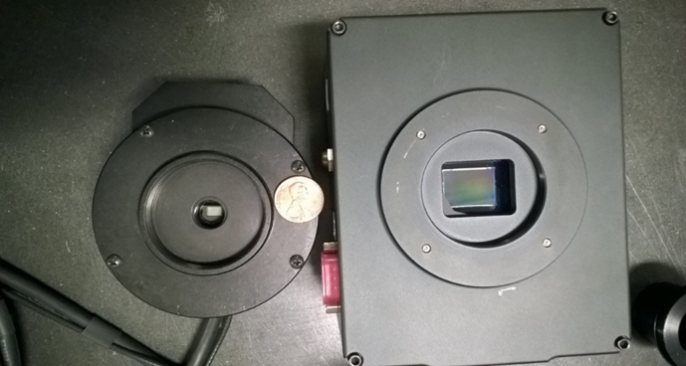
Introductory Astronomy Laboratory Visual Back and Camera Upgrade
Mariah N. Birchard, Faith K. Montgomery, Zachary R. Pruett, Kaitlyn L. Smith and David J. Sitar
Appalachian State University, Department of Physics and Astronomy
Abstract
A positive introductory astronomy lab experience is essential for drawing in new prospective majors and promoting an open attitude towards science for general education students. In order to provide students with a more engaging learning experience we are in the process of upgrading the Rankin GoTo Laboratory. Two “piggybacked” refracting telescopes; an 80mm Explore Scientific apochromatic refractor with a 480mm focal length and an 80mm Lunt achromatic refractor w
Experimental Setups and Results
Experimental Setups and Results (Cont’d)
Finder scope
We attached our third configuration, the VISTA3 along with the SBIG STF8300C back onto the 11-inch SCT. This configuration included a wide field lens, zoom lens, Moon filter, diffraction grating and flip mirror. This became our ideal setup. Below are images taken with this setup compared to those of our current setup.
Zoom lens
Focusing knob
Moon filter
Wide field lens
Cylindrical lens
Diffraction grating
Image 21: VISTA3
Image 1: The Rankin GoTo Laboratory
STV camera
Eyepiece
with a 560mm focal length, were tested on top of an 11-inch Schmidt Cassegrain Telescope (SCT). An SBIG STF-8300C CCD camera was included in the imaging experiment. The CCD has built in color capabilities and a chip size of 17.96x13.52mm, a significant upgrade from our current black and white cameras with a 4x5mm CCD chip. The SCT was also tested with the SBIG camera. All telescopes were tested to find the most effective and user-friendly imaging setup. The SCT demonstrated best results.
Flip mirror
Image 7: Mounting new camera
Image 20: VISTA3 capable of fitting between mount
Images 5 and 6: Current STV and VISTA setup
Objectives
Image 9: Hercules Globular Cluster (M13)
Image 23: Cigar Galaxy (M82), middle image cropped
Engage general education students
Adapt STEAM
Strengthen the introduction to modern astronomical imaging
Improve and update equipment
Improve and update software
User-friendly, versatile and reliable setup
Image 8: Ring Nebula (M57)
Image 10: Dumbbell Nebula (M27)
We took images using the SBIG STV (old camera) and then with the SBIG STF8300C (new camera). Looking at these images side by side, one will notice that the new setup provided color images and in a much wider field of view.
Image 22: Jupiter
Image 2: The team members
Image 25: Whirlpool Galaxy (M51)
Equipment and Software
Image 24: Great Orion Nebula (M42)
Image 26: Moon
Celestron CPC1100 Schmidt Cassegrain Telescope (SCT):
Specifications
Aperture ~ 280mm
Focal length - 2800mm
F ratio - f/10
Fork mount on wedge
Lunt Engineering, Achromatic Refractor:
ED doublet achromatic
Aperture - 80mm
Focal length - 560mm
F ratio - f/7
Explorer Scientific, Apochromatic Refractor:
ED triplet apochromatic
Aperture - 80mm
Focal length - 480mm
F ratio - f/6
New Camera (Kodak KAF-8300):
3326 X 2504 = 8.3Megapixels!
18mm x 14mm
> 3˚ F.O.V.
5.4µm² pixel size
0.09 – 3600s exposure times
Old Camera (Texas Inst. TC-237):
656 X 480 = 0.3Megapixels…
4mm x 5mm
< 0.5˚ F.O.V.
7.4µm² pixel size
0.001 – 600s exposure times
Image 13: Lunt Engineering Achromatic Refractor
Image 27: Spectrum of Sirius with SBIG STF8300C
Image 11: Reconfiguring VISTA to VISTA2
Image 12: Explorer Scientific Apochromatic Refractor
Image 28: Spectrum of Vega and Scheat with SBIG STV
Image 29: Spectral analysis of Sirius using RSpec
Image 3: Investigating software
We piggybacked the refractors using a dovetail system. The VISTA2 was split into two parts. Connected to the refractor was the STF8300C, diffraction grating, neutral density (Moon/planet) filter and zoom lens. Connected to the SCT was a permanent eyepiece, neutral density (Moon/planet) filter, zoom lens and wide field lens.
Conclusion and Future of Project
Nebulosity:
Simple, clean user interface
Quick to learn
Designed for controlling a single GoTo telescope and produce beautiful astrophotography
Power and flexibility in image processing
RSpec:
Simple processing
Spectra in color
Helpful tutorials and examples
Registax6 and AutoStakkert2:
Only stacks movie files
DeepSkyStacker, Mira, MaxIm DL and CCDOps:
Clunky user interface
Difficult to learn
Designed to control observatories and process huge amounts of scientific data
Limited image post-processing
In comparing the different setups, we found that our existing setup is readily available, however the camera is old, worn and uncooled. As for the CCD chip, it is small, and has observational limitations, which is doing a disservice to our current students. Our ideal setup provided color images with ease, has no cylindrical lens, allows us to use the original scope, has a large chip size and a much larger field of view. Therefore, this benefits our lab students.
In the future, we hope to replace all the cameras, computers, VISTAs and eyepieces in the Rankin introductory astronomy laboratory. We would also like to design and implement four new lab exercises. These would include remote observing, imaging with the new setup, image processing and spectral analysis of bright stars using RSpec. In addition, the Explore Scientific refractor will be used for wide field imaging and outreach events.
Image 14: Testing a refractor
Image 15: First light (spectrum)
Image 16: First light
Acknowledgements
Appalachian State University
Department of Physics and Astronomy
Office of Student Research
Professor Sitar
Mr. Dana Greene (Machinist)
Office of Student Research
Undergraduate Research Assistantship Program
Lunt Engineering
Tom Field (RSpec)
Mr. Leander Hutton (Imaging consultant)
Images taken and processed by Mariah Birchard, Leander Hutton, Faith Montgomery Joe Pollock, Zachary Pruett,
David Sitar and Katie Smith
Image 17: First astronomical light of the Moon
Images 18 and 19: First astronomical light of the Great Orion Nebula (M42) (uncropped and cropped, respectively)
Image 31: Wide field of the Leo Trio
Image 4: CCD comparison
Image 30: Design with new mount for fieldwork

